Slide 1
CSE 212 : OBJECT ORIENTED PROGRAMMING SESSIONAL
Presented To :
Md. Muhtadir Rahman
Lecturer
Department of Computer Science and Engineering
Port City International University.
Project Title : Tech Warehouse Information.
Prepared by :
Mohammad Shohid Afridi - CSE (02106968).
Mohammad Ibrahim Khalil - CSE (02107000).
Md. Yeasin Hossain - CSE (02106974).

Slide 2
CONTENTS
Activity Diagram
User Interface (UI)
Cost Analysis
Thank you
Q & A
Problem Statement
Problem Objectives
Preliminary Solutions
Project Scopes :
Functional Requirements
Non – Functional Requirements
Project Stakeholders

Slide 3
01
Problem Statement
In a big store or warehouse, there is a lot of components like Processor, RAM, Keyboard and all the PC Accessories.
As there is a lot of PC Accessories, it is hard to keep the information of all the product together.
Moreover, the price of the Tech Products are hard to remember because of variety of components.

Slide 4
Problem Objectives
02
The main objective of the Tech Warehouse Information is to provide the product's price and quantity in our stock and we can also update it.
It manages the details of the components, their price and their quantity.
The project only the administrator is guaranteed the access.
The purpose of this project is to reduce the manual work.

Slide 5
Preliminary Solutions
03
The problem with the remembering all the product details can be easily resolved by this “Tech Warehouse Information” application.
The data of the products will be stored in database by this system.

Slide 6
Project Scopes
04
Functional Requirement :
Login system.
Information insert, update and delete.
Non-Functional Requirement :
The User will be using XAMPP.
The information / data will be saved in MySQL database.

Slide 7
Project Stakeholders
05
“Tech Warehouse Information” system stakeholders are :
Sales Man
Executive Manager
Company Investors
Company Suppliers

Slide 8
06
Executive Manager :
Executive Manager will look after overall transaction and quantity of products by checking database from this program.
Company Investors :
Company Investors will check all products quantity if we have lack of products as compared to market demand, then they will contact the suppliers.
Company Suppliers :
They will supply the products as our demand.
Sales Man :
They can insert, delete and update products data after
selling items by using this program.

Slide 9
07
Activity Diagram
Start
Login
Main Interface
Insertion
Update process
Deletion
Searching
Enter information
Enter information
Select Product
Select Product
Insert
Delete
Search
Update
Data Inserted
Data Deleted
Information Showed
Data Updated

Slide 10
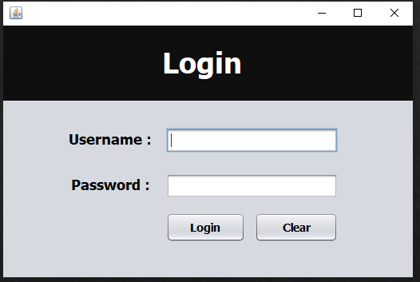
User Interface (UI)
08
Login Panel

Slide 11
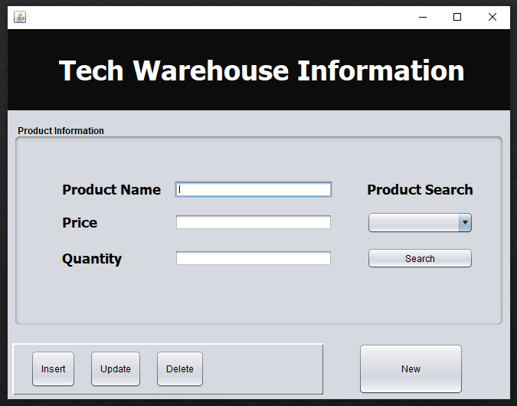
User Interface (UI)
09
Front View

Slide 12
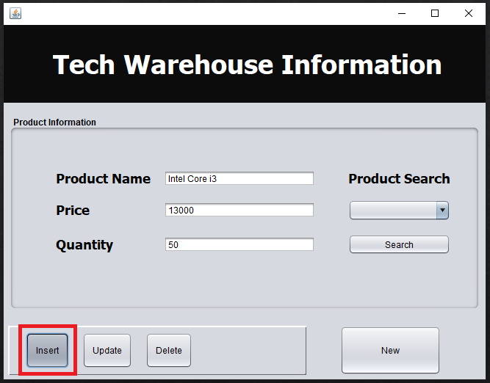
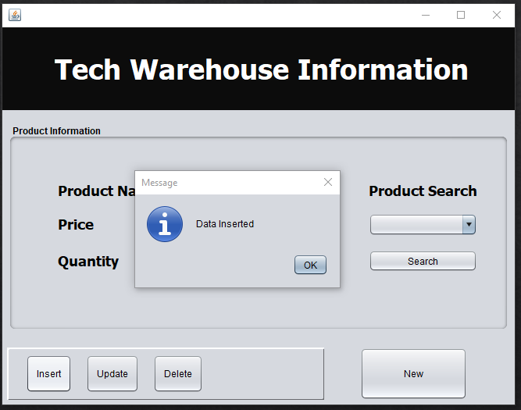
User Interface (UI)
10
Insertion :
Before
After insert

Slide 13
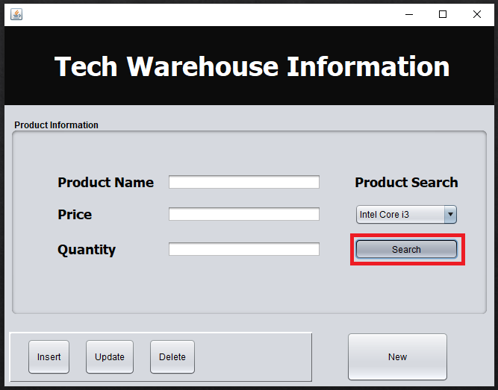
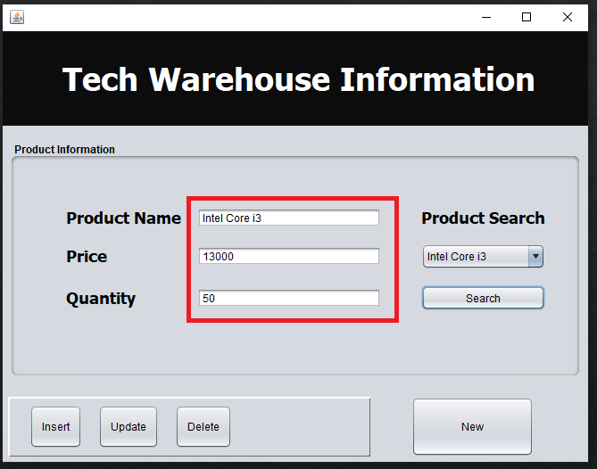
User Interface (UI)
11
Update Process :
Before

Slide 14
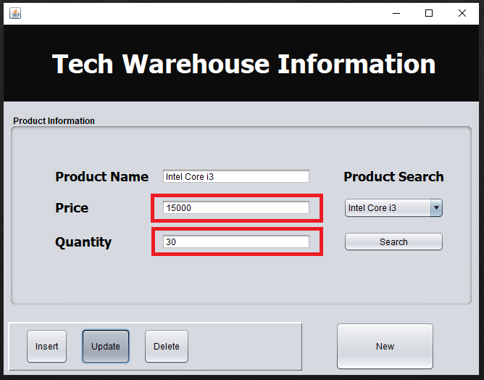
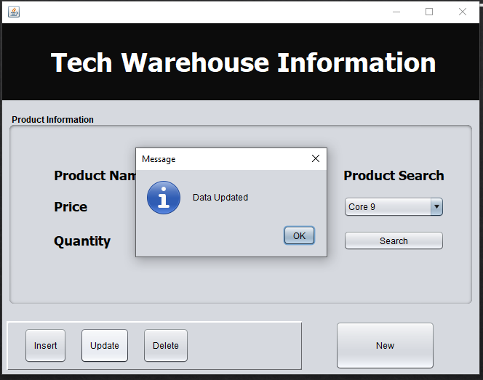
User Interface (UI)
12
After

Slide 15
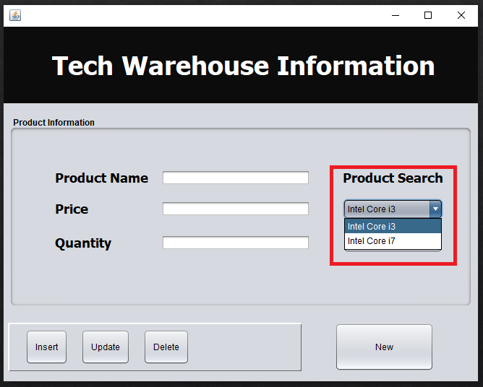
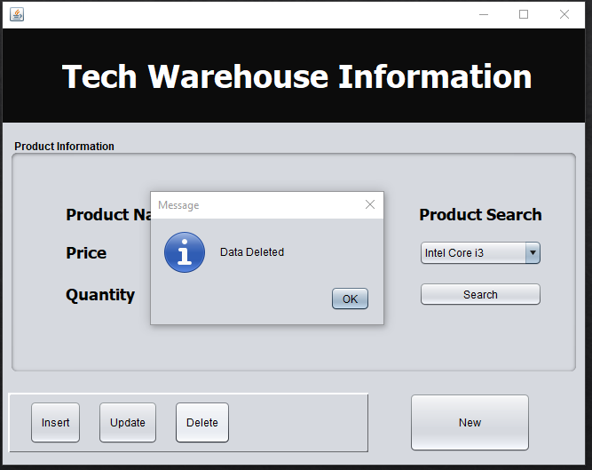
User Interface (UI)
13
Deletion :
Before

Slide 16
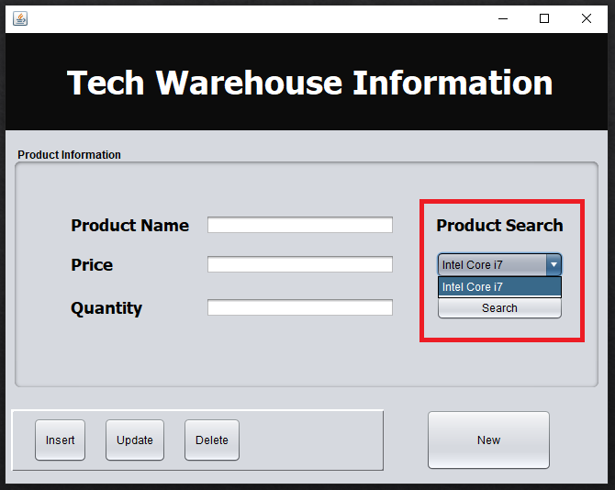
User Interface (UI)
14
After

Slide 17
Cost Analysis
15
Serial No | Item | Amount
01 | Application Software Development | 1,20,000
02 | Personal PC | 2,40,000
03 | Web Server | 50,000
 | Total | 4,10,000

Slide 18
THANK YOU

Slide 19
Q&A

